Slide 1
SEPIC Converter as A Constant Current LED Controller
Nick Cardamone – Electronics 3 – Nov 18 2022

Slide 2

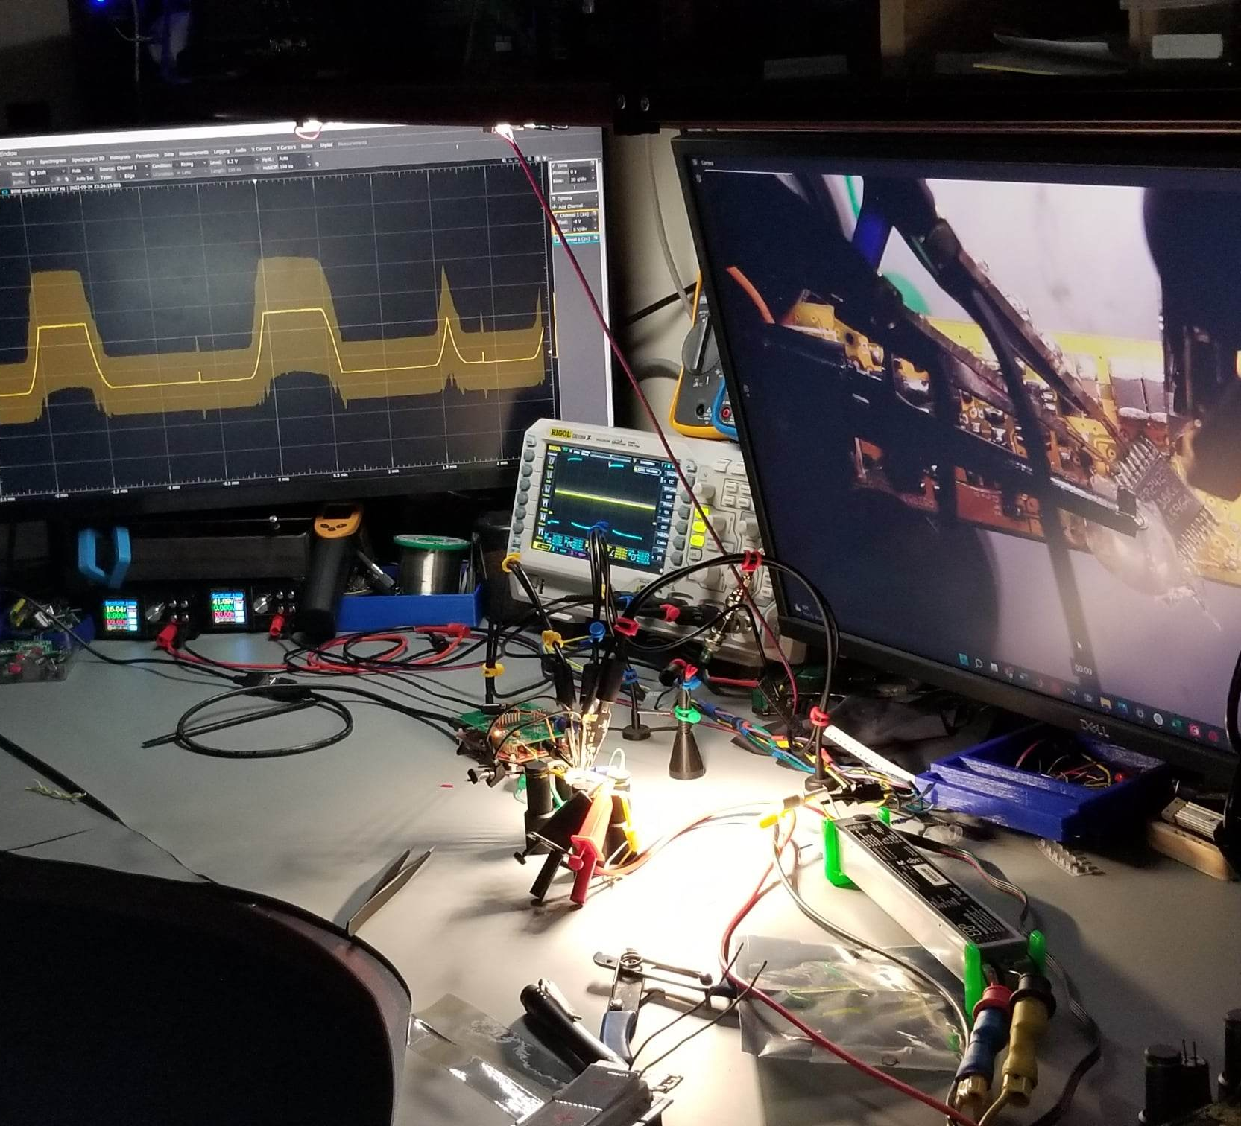
Background
Did coop terms working at LED lighting company designing LED controllers
Use scrap light engine for a desk lamp
Currently use a bench supply to power the light engine

Slide 3
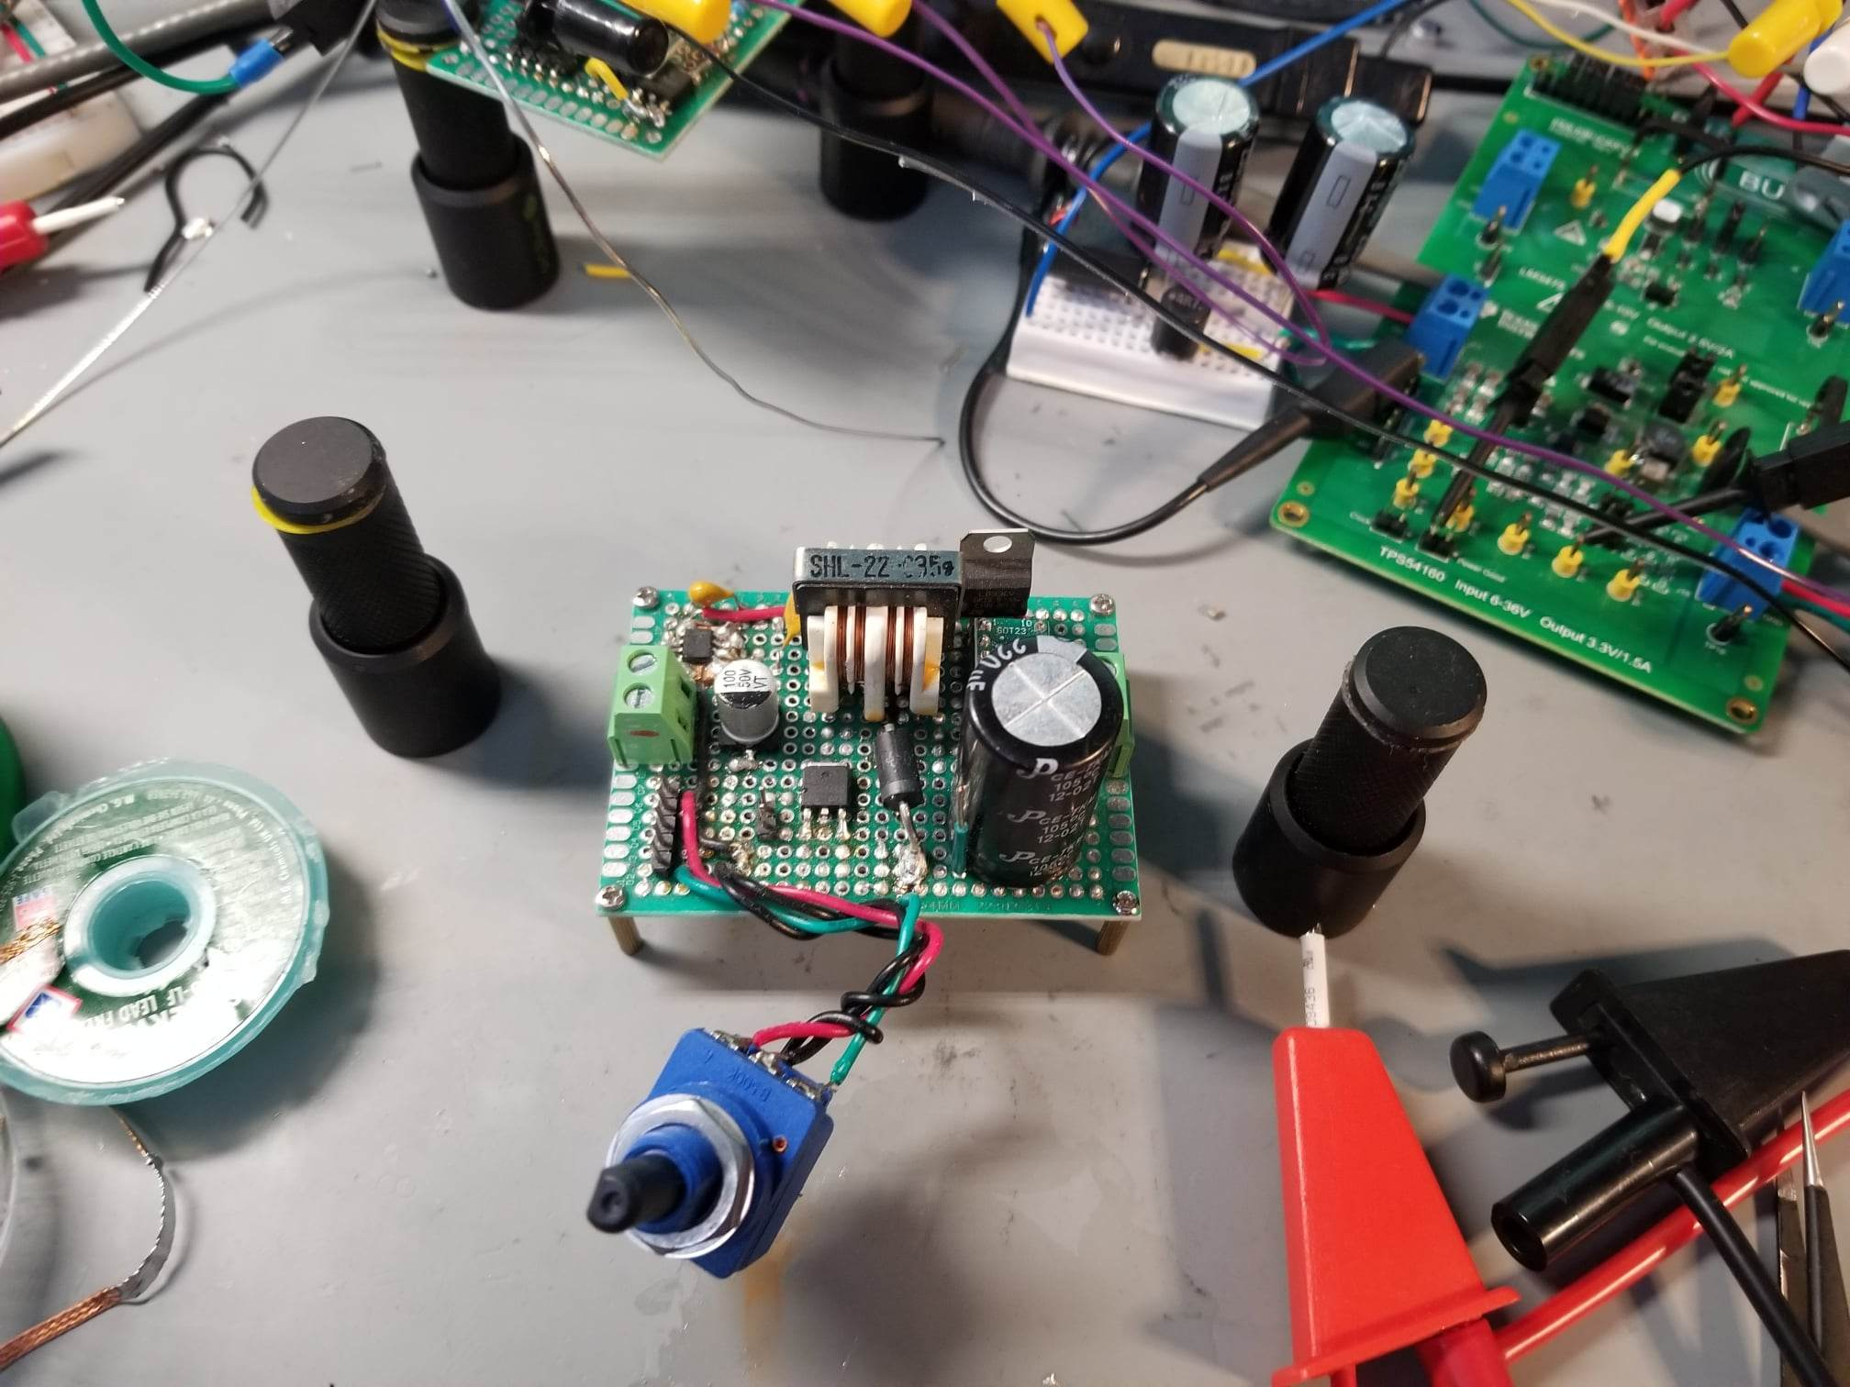
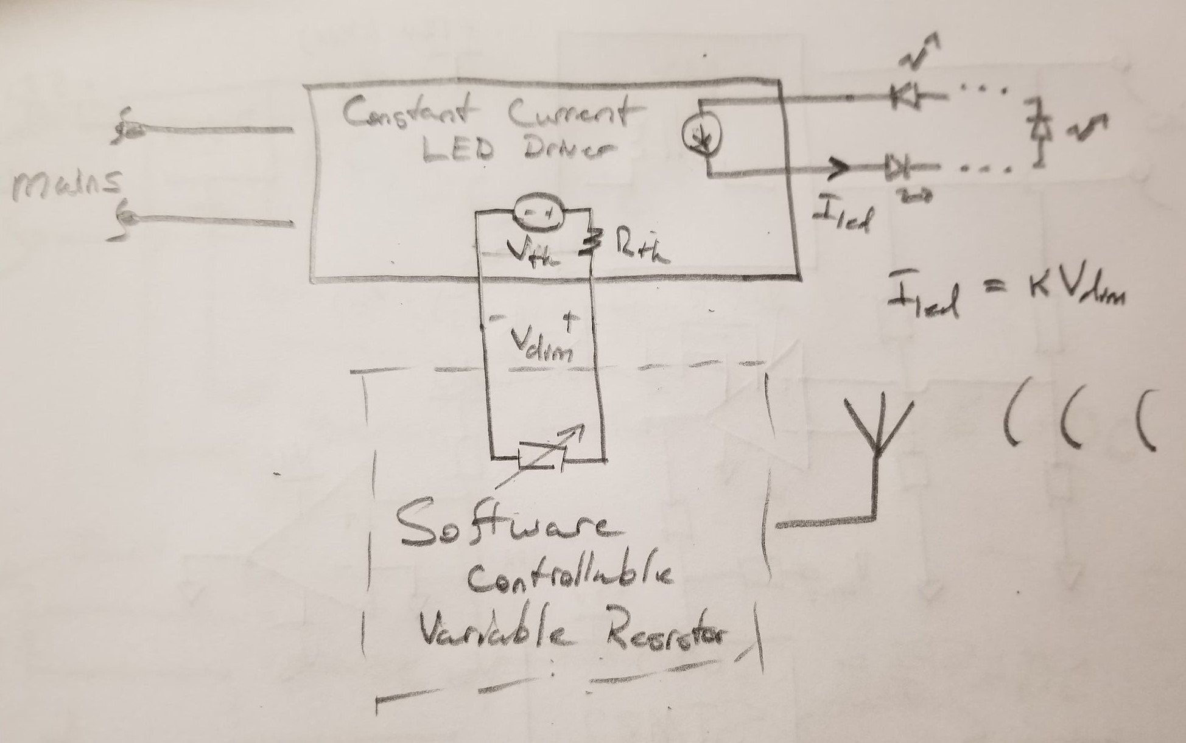
Hardware Goals
12V Wall Wart
Pot
No Bluetooth
Previous Prototype
I have a need for a contant current power supply (not a channel of a bench supply) to use to power my desk lamp

Slide 4
Presentation Overview
Background and Motivation
Problem Statement and Hardware Goals
Circuit Diagram
PCB Layout
PCB 3D View
Simulations
Design Methodology
Left TODO

Slide 5
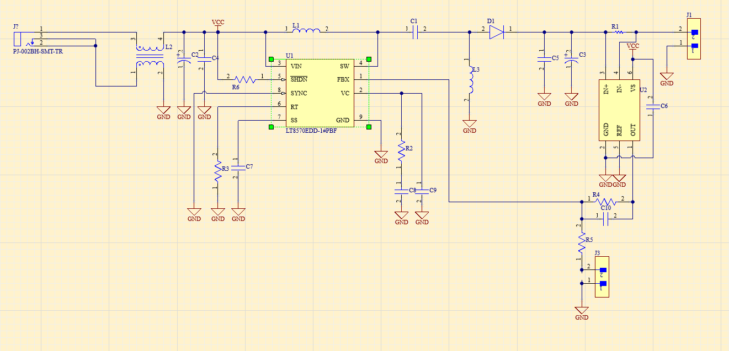
Circuit Diagram
Sepic converter with current feedback

Slide 6
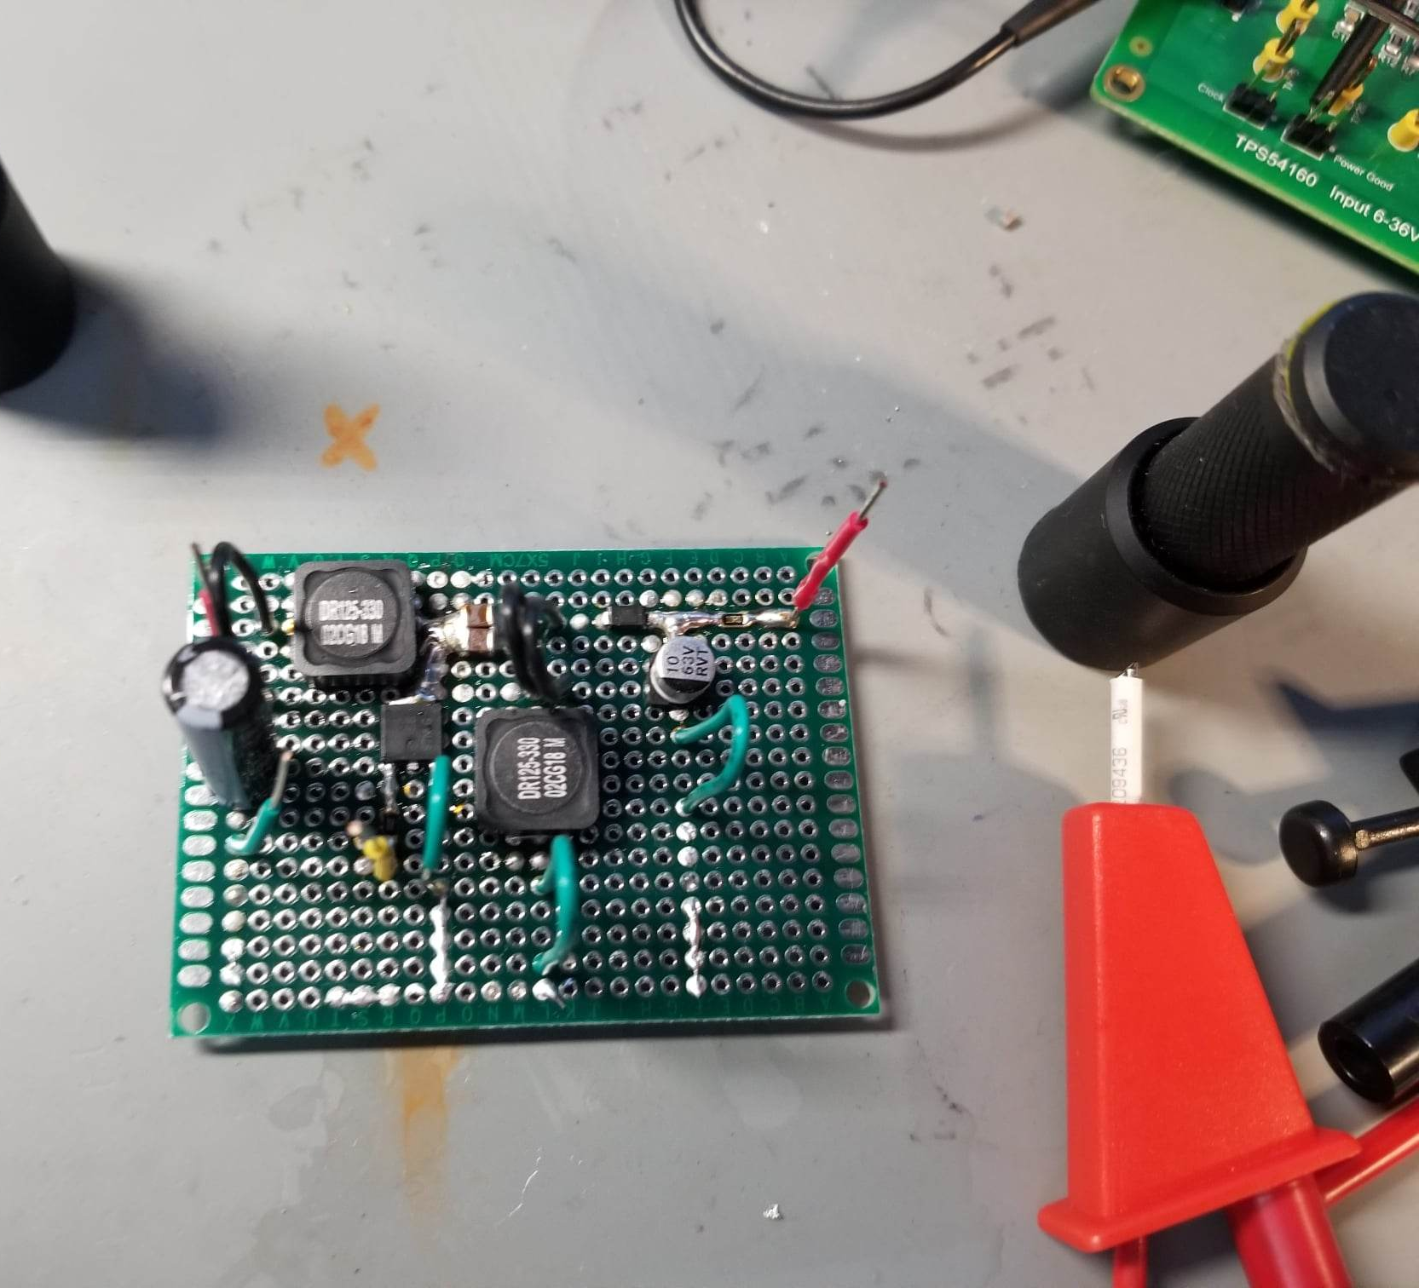
Prototype
Open Loop Only

Slide 7
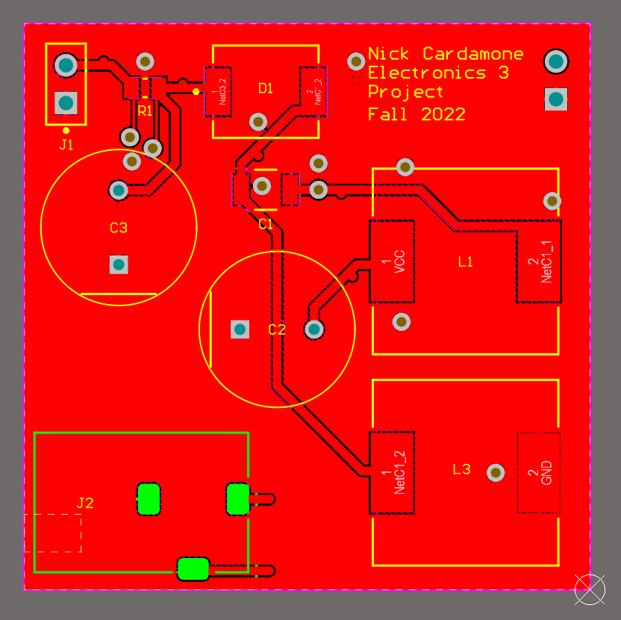
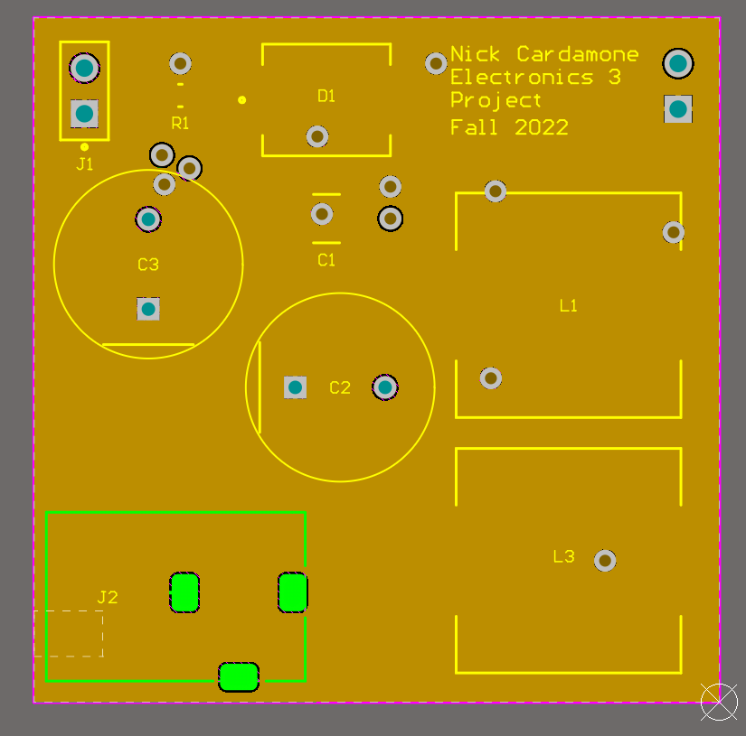
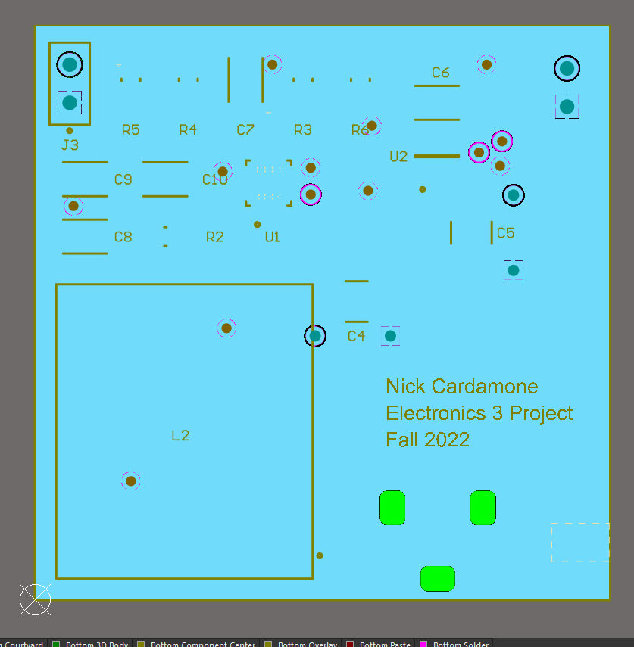
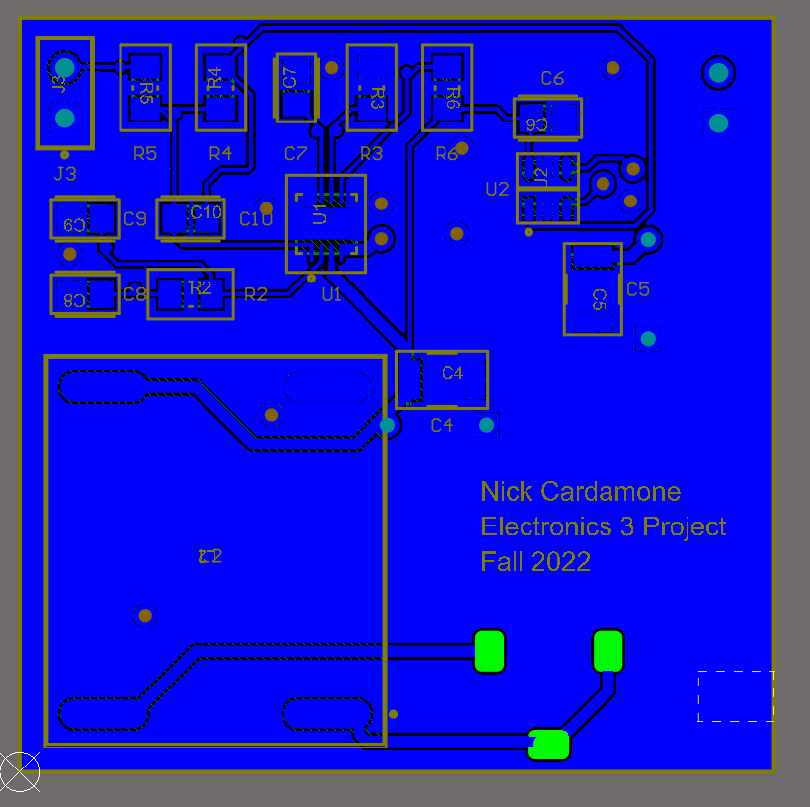
PCB Layout
Layer Stack: Top, Gnd Plane, Gnd Plane, Bottom

Slide 8
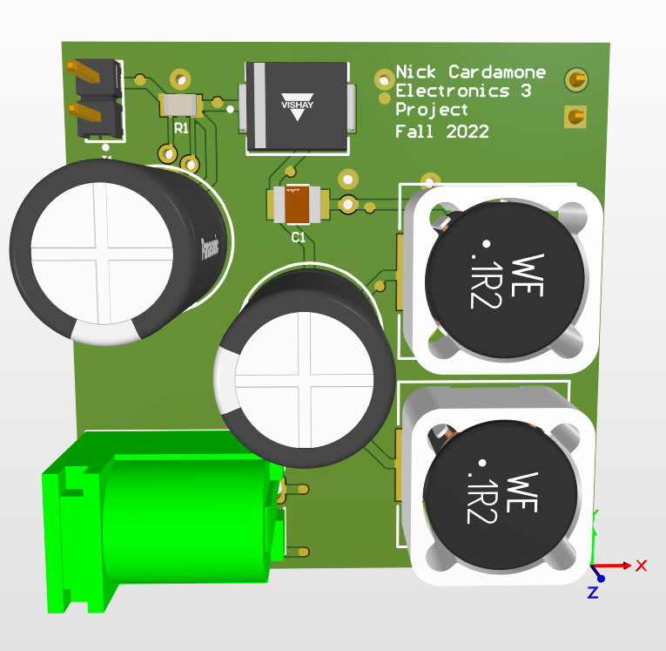
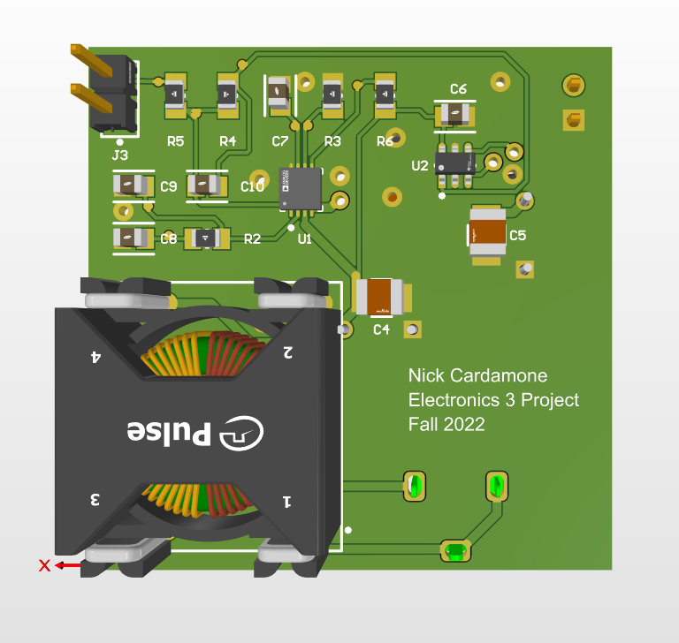
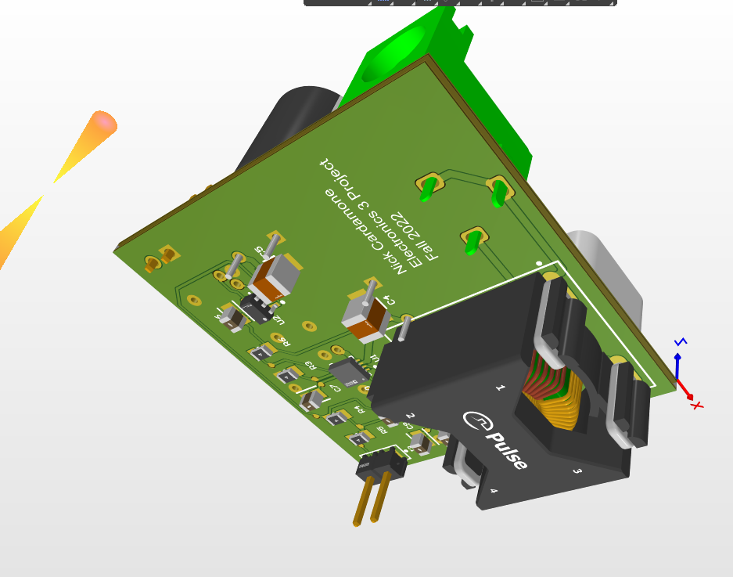
PCB

Slide 9
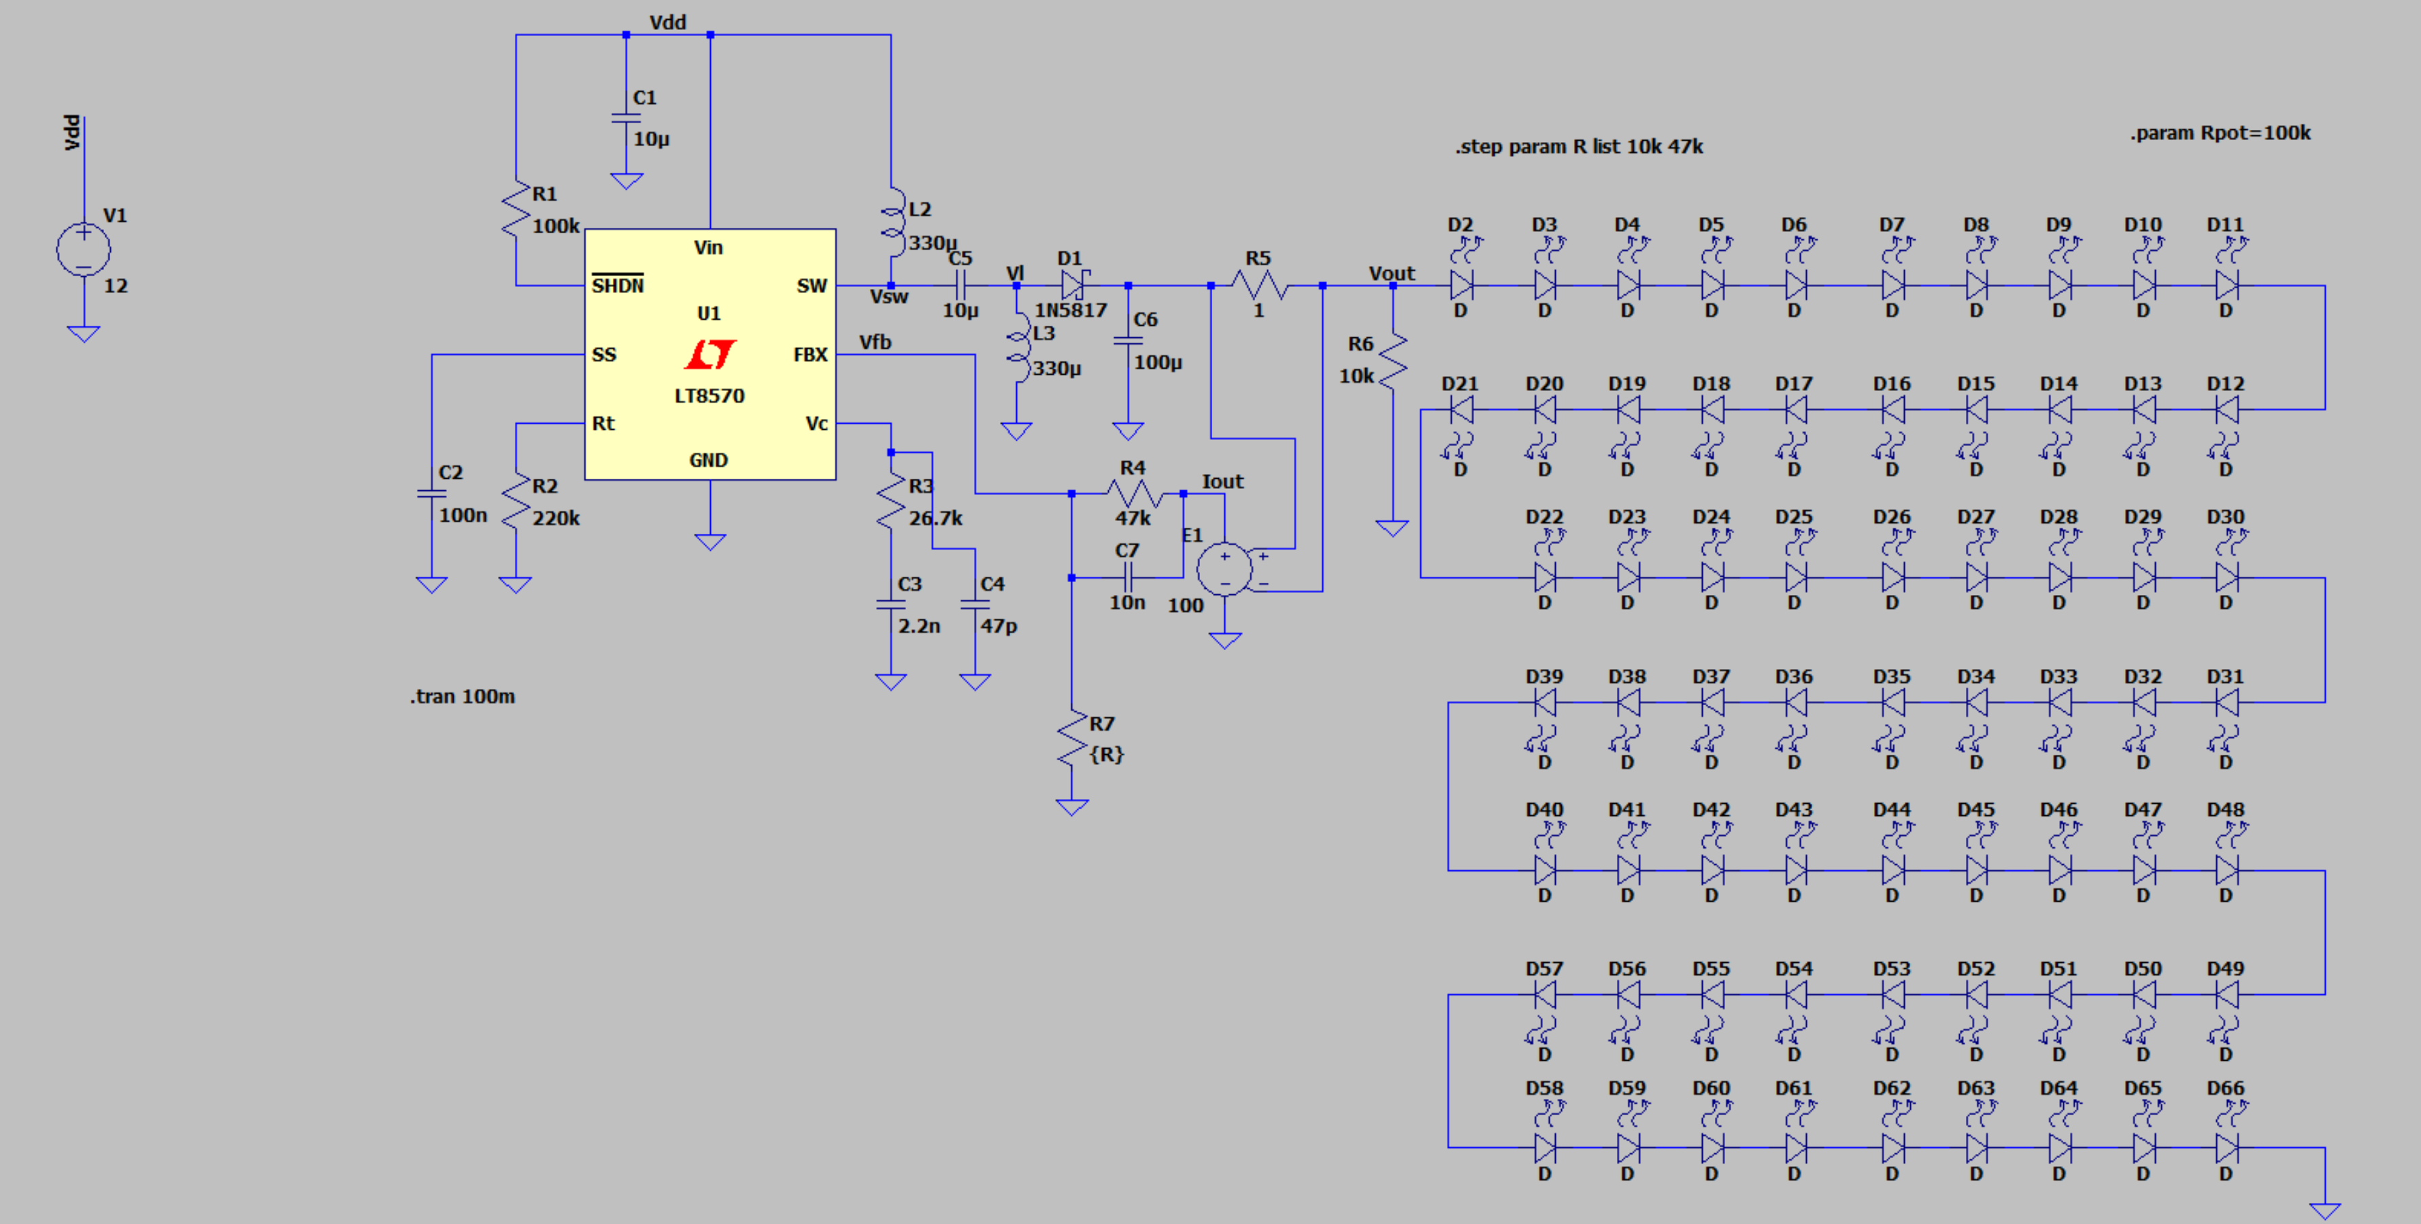
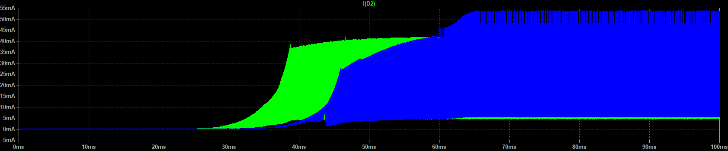
Simulations
Still large LED current ripple (called flicker in industry)
Undesirable but not end of the world

Slide 10
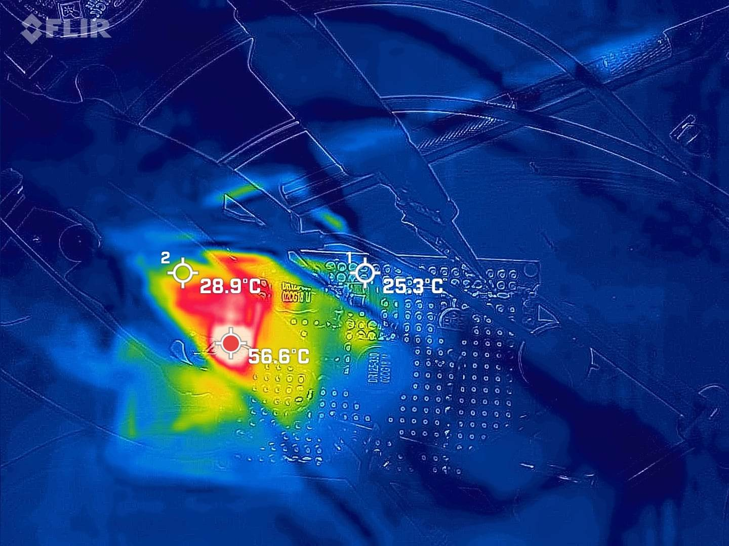
Thermals
Max Temp: 56.6C (Input inductor on prototype)

Slide 11
Design Steps
Search through Digikey for SEPIC Converter IC
Read datasheet
Power Stage: convert design equations into code, brute force for component values
Compensator
Bode plot of power stage transfer function
Bode plot of 1/feedback transfer function
Intersection needs closure of 20 dB/dec for 45 degrees of phase margin
RHPZ is a problem, put converter into DCM to eliminate problem
Simulate circuit (LTSPICE) and iterate and refine component values

Slide 12
Left todo
PCBs arrive today/ there are on a truck now (ordered a week late because I had covid)
Components need to be soldered on
Component values need to be finalized
Encasement needs to be made (probably out of Al, PCB submerged in oil for passive cooling)
Simulate PCB with Ansys sim tool (sim tool doesn’t have good documentation that I can find)
Characterize converter and generate plots for final report

Slide 13
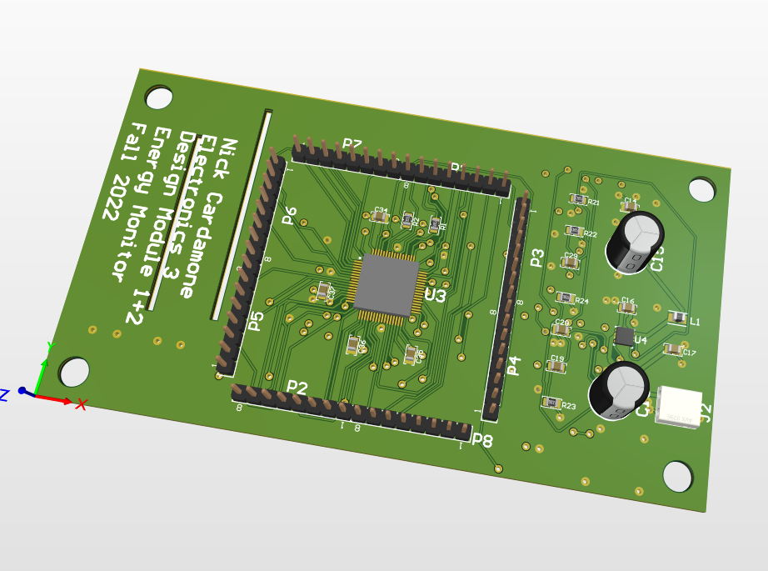
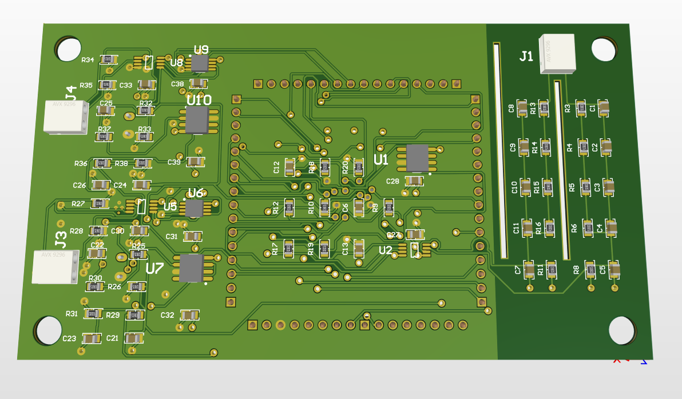
Design Module 1 PCBs
(why I was a week late ordering)

